Slide 1
Global PSP Project for Indian Embassies and Consulates
Quick Guide – Enrolment Officer (EO) Users’ Application

Slide 2
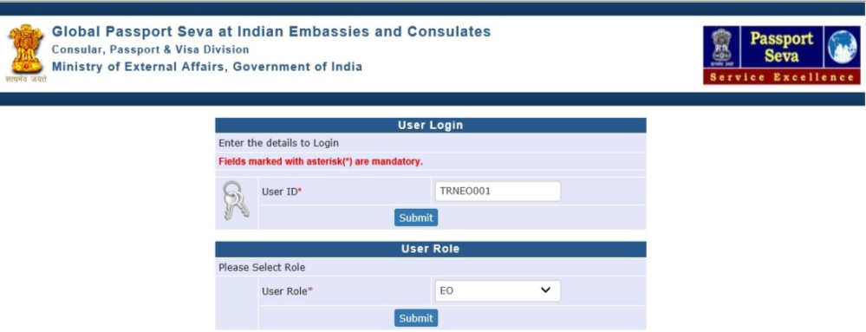
Login Using User ID, Password, and Grid Values
Visit Global PSP Office Portal (https://embassy.passportindia.gov.in)
Enter User ID
Press Submit button
Choose User Role as ‘EO’
Press Submit button displayed below the User Role

Slide 3
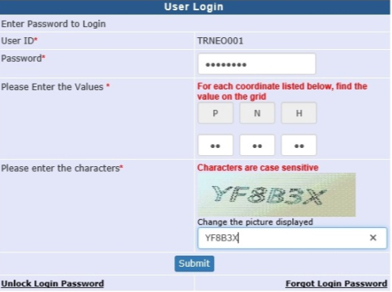
Login Using User ID, Password, and Grid Values (continued..)
Enter Password
Check your User Grid and enter the values for the three alphabets displayed on the screen
Enter the characters displayed in the CAPTCHA image
Press Submit button

Slide 4
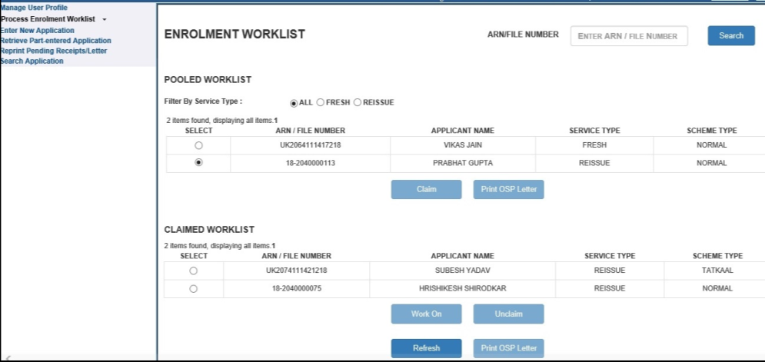
Process Enrolment Worklist screen
Enrolment Worklist screen appears on clicking the Process Enrolment Worklist link and displays the Pooled and Claimed Work-items’ list
Items displayed in Pooled Work list can be claimed for processing by any EO user in the respective Mission/Post (visible to all EO users)

Slide 5
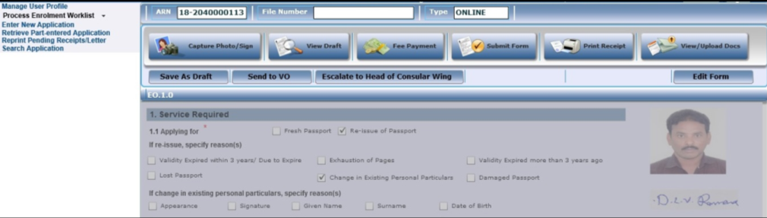
Process Enrolment Worklist screen (continued..)
Application details for the selected file will appear after pressing the Claim button in worklist screen
Notes:
Ideally choose a screenshot showing both varieties of Index Check Readiness status

Slide 6
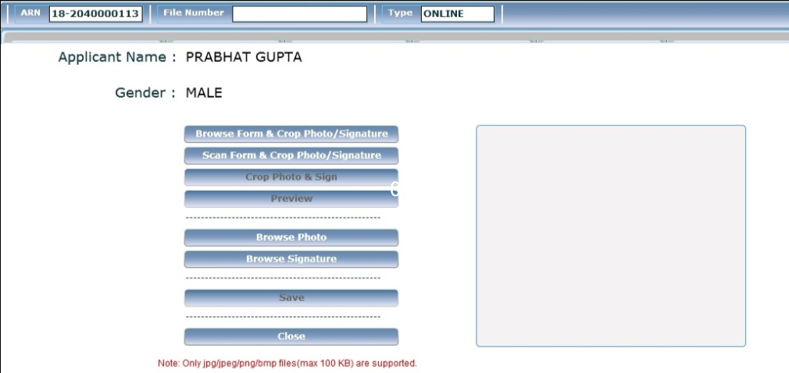
Capture Photo/Sign screen (continued..)
EO User can upload photo and signature images of the applicant (if required) not clear by clicking the ‘Capture Photo/Sign’ button
Photo and Signature can be uploaded in multiple ways (directly browse & upload the image / browse form & crop image / scan form & crop image)

Slide 7
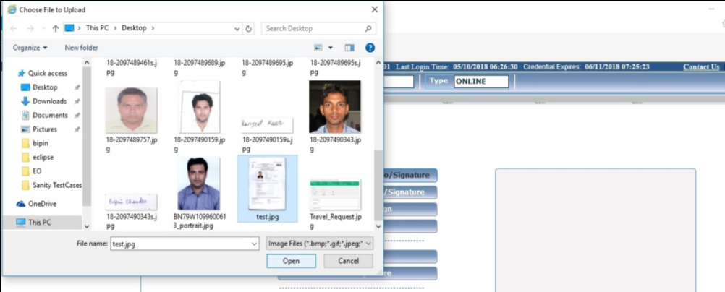
Capture Photo/Sign Sub screen (continued..)
Browse Form & Crop Photo/Sign’ button can be clicked to view the electronic application form to crop photo/sign only if it is already scanned.
User can also browse Photo and Sign images directly or use the scanning device (if integrated with EO machine) to scan the physical application form to crop the photograph/signature image

Slide 8
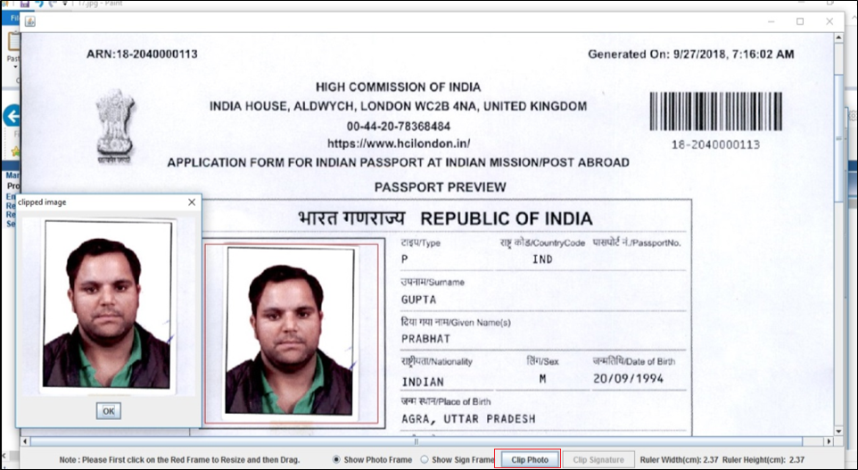
Capture Photo/Sign Sub screen (continued..)
Click on Clip Photo button to crop photo of the applicant

Slide 9
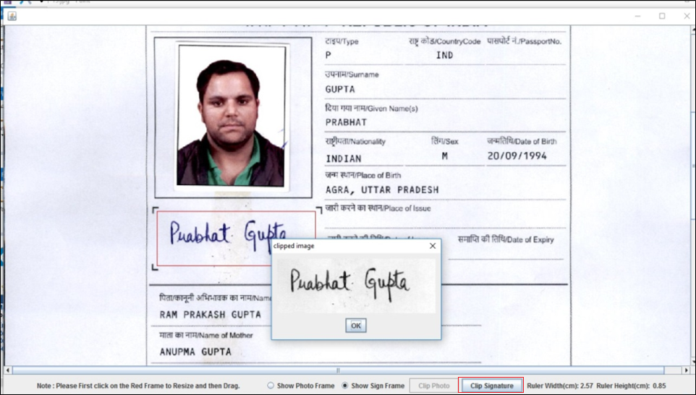
Capture Photo/Sign Sub screen (continued..)
Click on Clip Signature button to crop signature of the applicant .

Slide 10
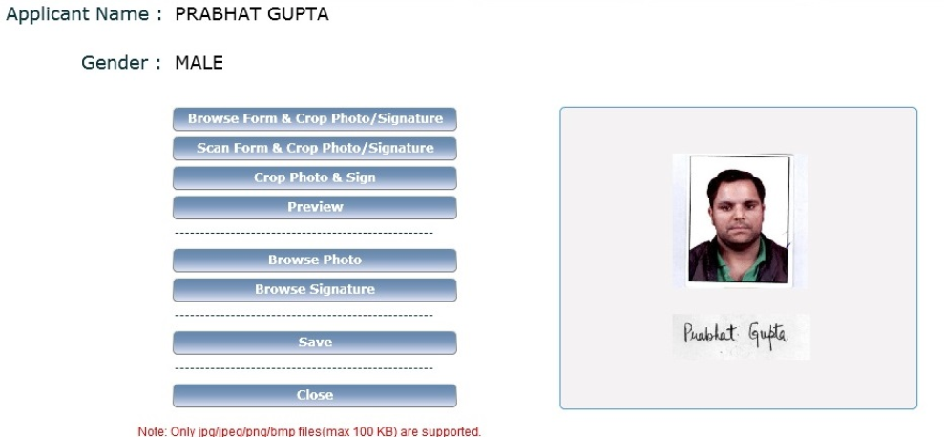
Capture Photo/Sign Sub screen (continued..)
Click on Preview button to see the preview of the applicant's photo and signature
Click on Save button to save the changed photo and signature

Slide 11
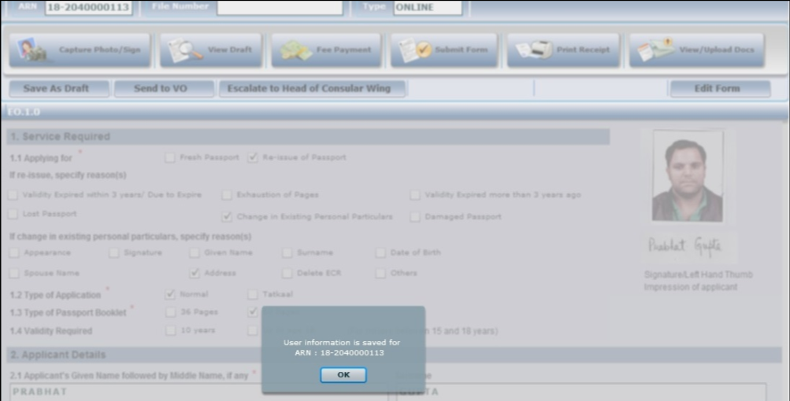
Process Enrolment Worklist screen (continued..)
Click on 'Save as Draft' button to save the changes done by EO user

Slide 12
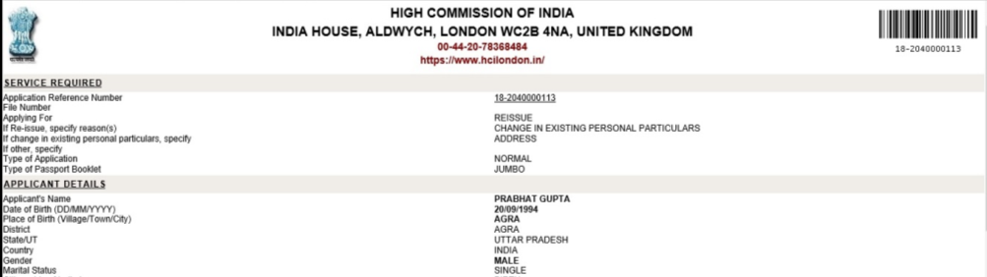
View Application Details sub-screen
This sub-screen opens when View Draft button is clicked in the Process Enrolment Worklist screen
All application form fields are visible in this screen

Slide 13
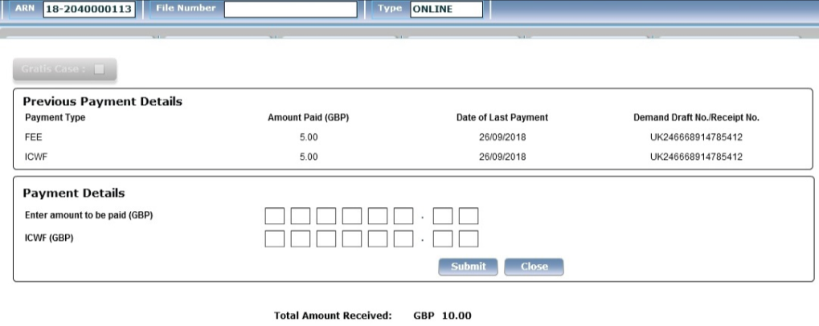
Fee Payment sub-screen
EO user can view all the payments previous made for the application by clicking on the Fee Payment button
EO user can also confirm additional payment details by entering the amount in the check-boxes displayed on the screen and clicking on the Submit button
Notes:
Replace screenshot so that all passports display same name of the applicant (Notice KANAK GUPTA and YUSUF SIDDIQUI)

Slide 14
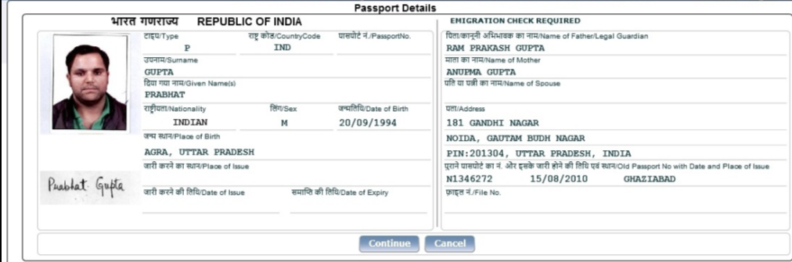
Passports Details sub-screen
Click on Submit Form button to preview the passport printable details
Click on Continue button to proceed for further processing or click on Cancel button to revisit the details (which can be changed after clicking the Edit Form button)
Notes:
Replace screenshot so that all passports display same name of the applicant (Notice KANAK GUPTA and YUSUF SIDDIQUI)

Slide 15
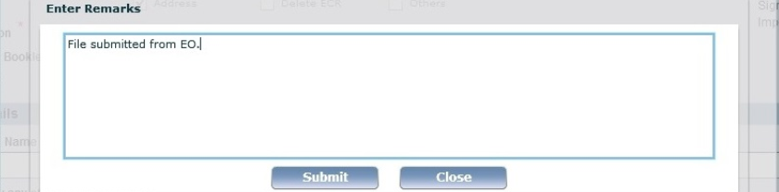
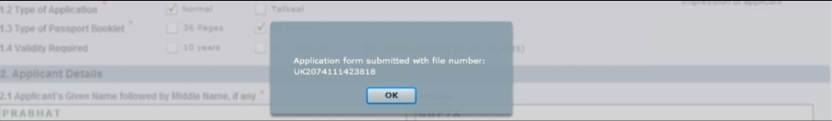
View Activity Trail sub-screen
After clicking on the Continue button in the Passport Preview screen, user is prompted to enter Remarks before final submission
After entering the Remarks and clicking the Submit button - a unique 15 characters long PSP File Number will be generated for the application
Note: Application details cannot be changed after generation of the File Number until the file is sent to VO/MissionHead and then sent back to EO by VO/GO/MissionHead users for editing data/documents

Slide 16
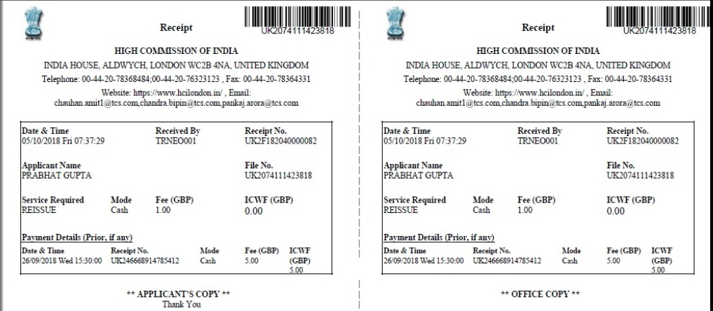
Fee Receipt sub-screen
This sub-screen opens when Print Receipt button is clicked. The screen shows the details of payment made

Slide 17
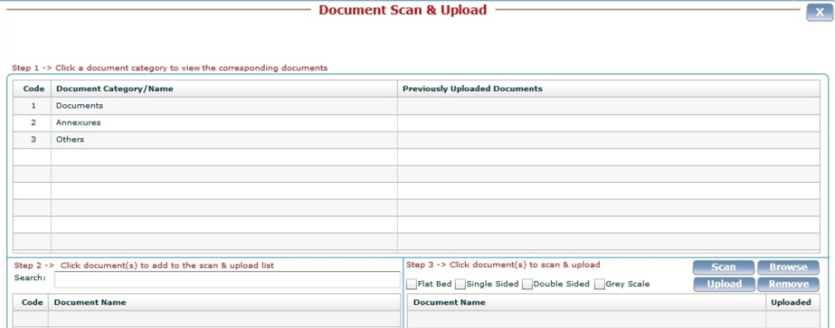
Document Upload Sub Screen
Click on View /Upload Document button to upload (browse pre-scanned, or scan afresh) the electronically scanned documents to be attached to the application

Slide 18
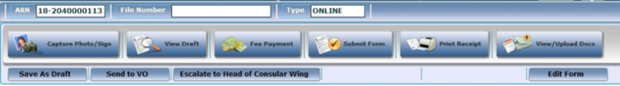
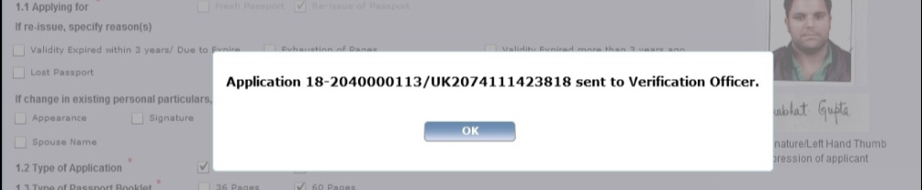
Process Enrolment Worklist screen (continued..)
Click on Send to VO button to send the file to the Verification Officer (VO) user
Alternatively (in case of some doubts requiring inputs from Head of Consular Wing/Passport Section at Mission/Post) - click on the Escalate to Head of Consular Wing button to seek his/her guidance/instructions for further processing

Slide 19
In case of additional information or clarification, please contact Global PSP Support Team at
Email : global.psp@tcs.com
Phone : +91-0120-672-9595/96
Mobile : +91-730-351-9595
Thank You

